Slide 1

Airline Passenger Sentiment Analysis Using Deep Learning
Course: AASD 4010 – Deep Learning I
Professor: Moe Fadaee
TA: Robert Kaczur
Faimina Bharatbhai Khokhani | ID 101502974
October 4, 2025

Slide 2
Project Overview
• Social-media feedback drives airline reputation.
• Goal → automate tweet sentiment classification (positive, neutral, negative).
• Complete workflow: EDA → Model Development → Deployment.
• Tools: Python, TensorFlow/Keras, Hugging Face, Gradio, Tweepy.

Slide 3
Dataset & EDA
Source: Kaggle – Twitter US Airline Sentiment (~14 000 tweets).
• 64 % Negative | 21 % Neutral | 15 % Positive.
• Tweets < 150 characters → ideal for sequence models.

Slide 4
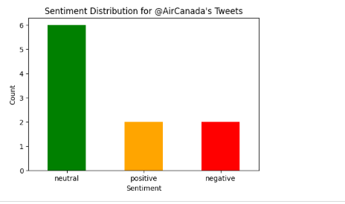
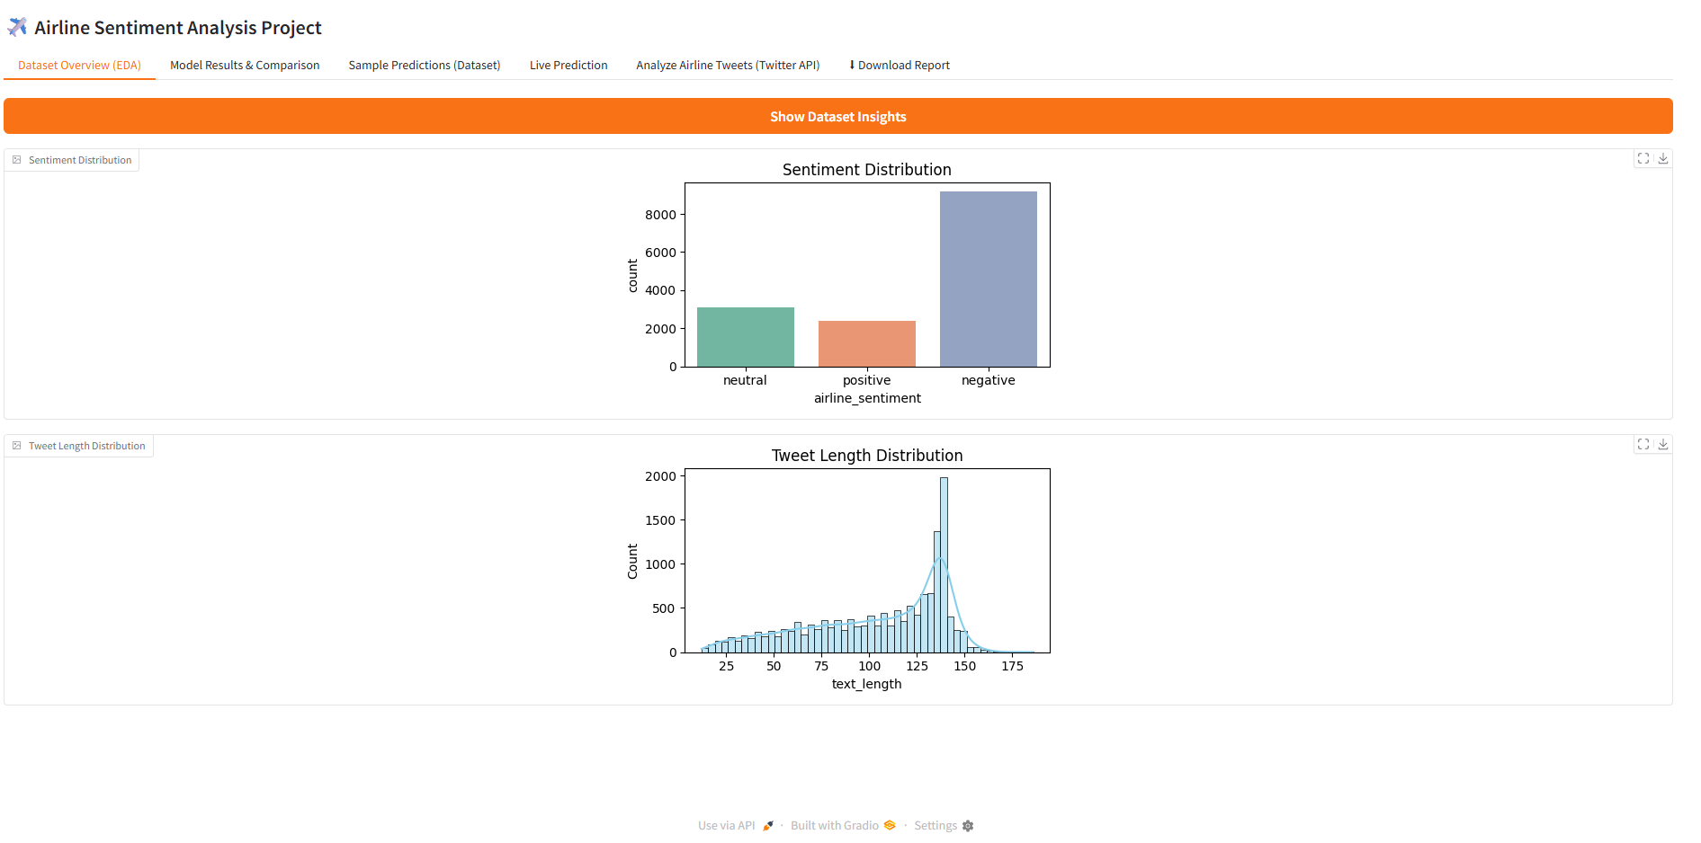
( Figure 1 – Dataset Sentiment Distribution)
( Figure 2 – Tweet Length Distribution)

Slide 5
Data Pre-Processing
Removed URLs, mentions, punctuation, lowercased text.
• Tokenized (max len 150) and padded sequences.
• Encoded labels (0 = Neg, 1 = Neu, 2 = Pos).
• Split: 80 % train | 10 % validation | 10 % test.

Slide 6
Baseline Model
(TF-IDF + Logistic Regression)
Converts text to numerical vectors using TF-IDF.
• Logistic Regression classifier as baseline.
• Accuracy = 78.17 %, Macro F1 = 0.70.
• Serves as benchmark for deep models.

Slide 7
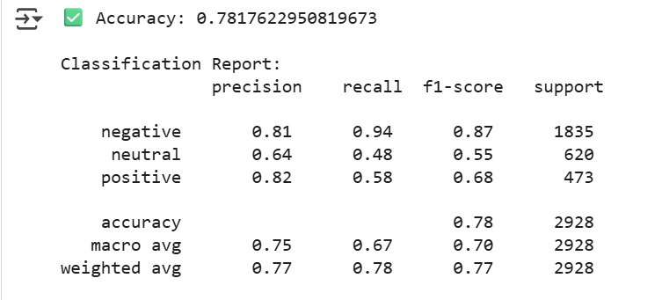
(Figure 3 – TF-IDF Classification Report)

Slide 8
GRU Model
• Architecture: Embedding(20 000, 128) → GRU(64) → Dense(3, softmax).
• Handles sequential data but underfitted with limited dataset.
• Accuracy = 62.7 %, Macro F1 = 0.26.

Slide 9
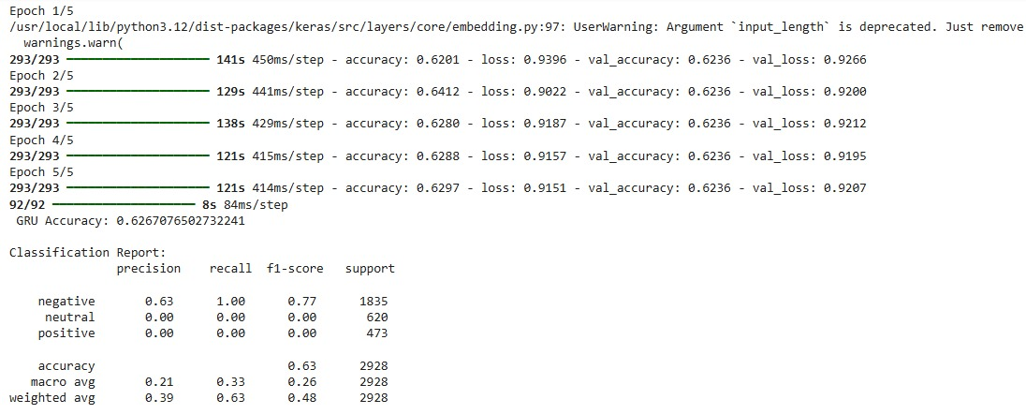
Figure 4 – GRU Training Accuracy and Loss

Slide 10
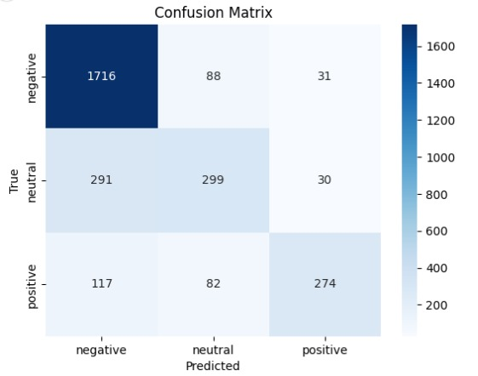
Figure 5 – GRU Confusion Matrix

Slide 11
Transformer Model (DistilBERT)
• Pre-trained model from Hugging Face: CardiffNLP/twitter-roberta-base-sentiment-latest.
• Fine-tuned for 5 epochs (lr = 2e-5).
• Accuracy ≈ 89 %, F1 ≈ 0.88 → best overall.

Slide 12
Figure 6 – DistilBERT Training Summary
Figure 7 – Evaluation Output

Slide 13
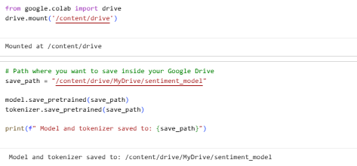
Model Saving & Deployment
Figure 8 – Model and Tokenizer Saved to Drive
• Saved model and tokenizer to Google Drive for reuse.
• Built interactive Gradio app for real-time predictions.

Slide 14
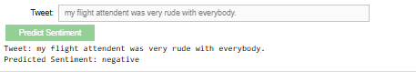
Prediction Example
• Example tweet: “My flight attendant was very rude with everybody.”
→ Predicted Negative.
• Demonstrates full pipeline from pre-processing to inference.
Figure 9 – Prediction Example

Slide 15
Live Tweet Analysis
• Used Tweepy API to fetch tweets from @AirCanada.
• Classified tweets in real time using DistilBERT model.
• Most tweets neutral → balanced public sentiment.

Slide 16
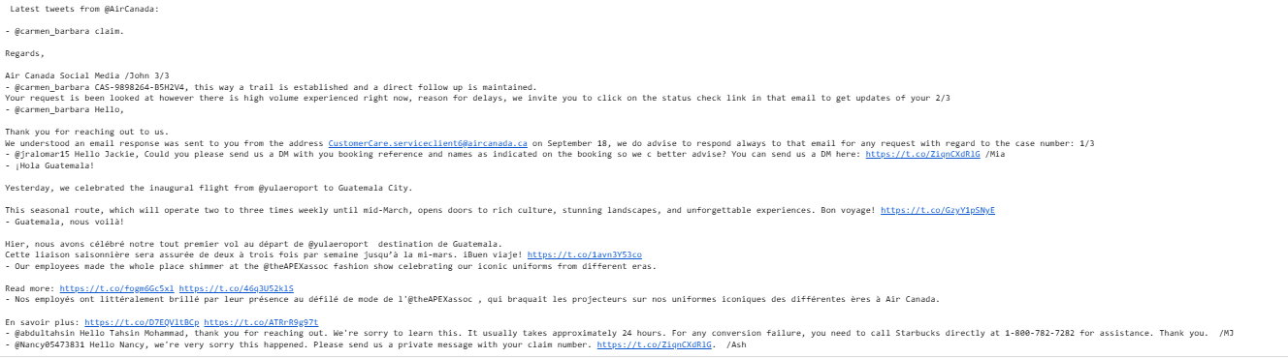
Figure 10 – Tweets Fetched from @AirCanada

Slide 17
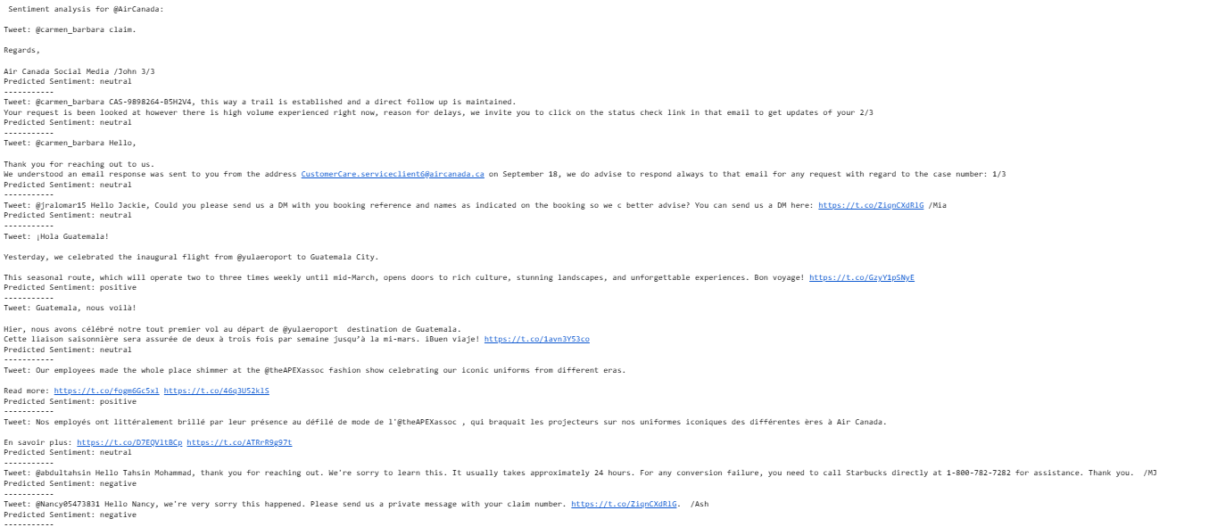

Slide 18
Gradio Dashboard Interface
•Multi-page app showing EDA, model comparison, predictions, and live analysis.
• Enables non-technical users to explore results visually.
•Gradio app exports results as downloadable text report.
• Enhances reproducibility and documentation.

Slide 19
Figures 12 – 18 series showing interface pages

Slide 20
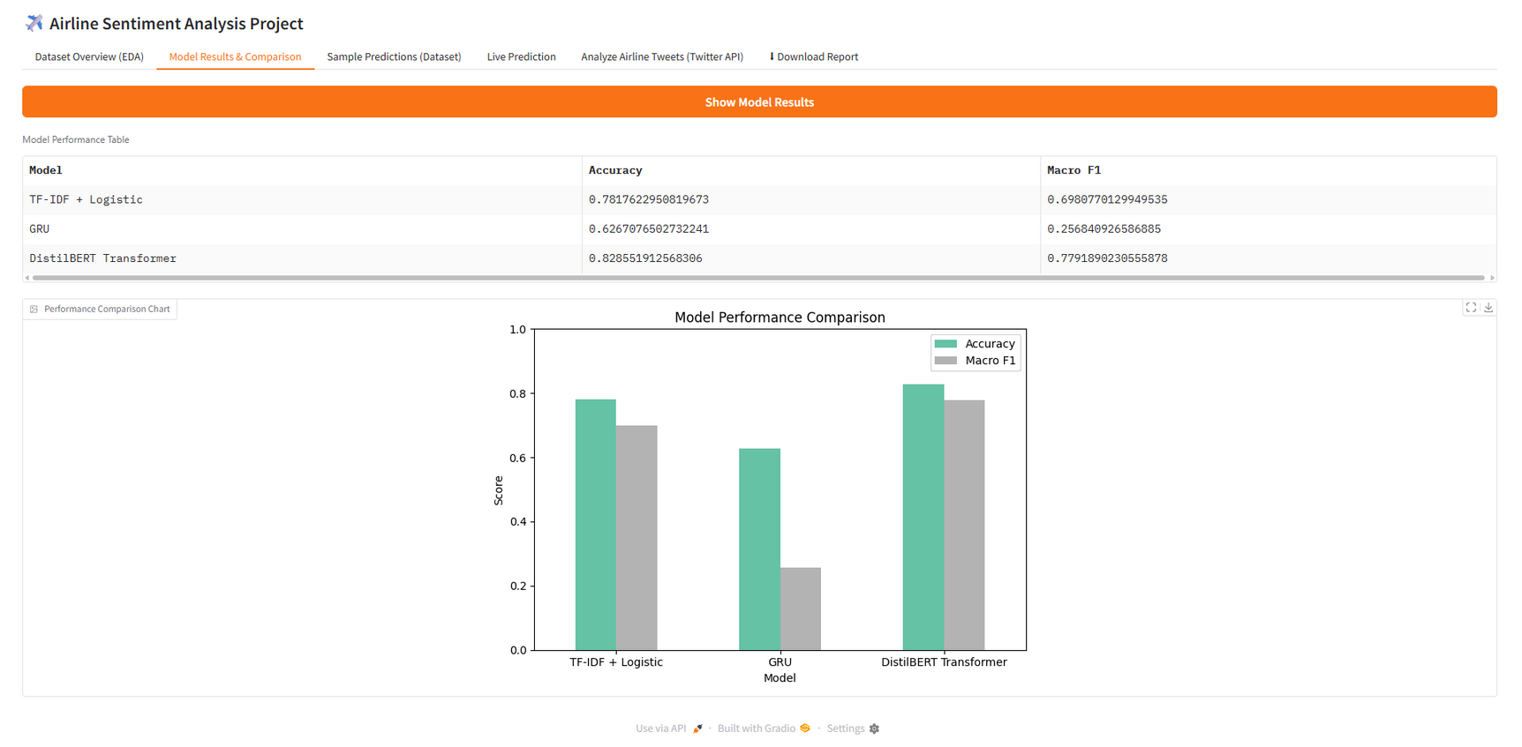
Figures 13 showing interface pages

Slide 21
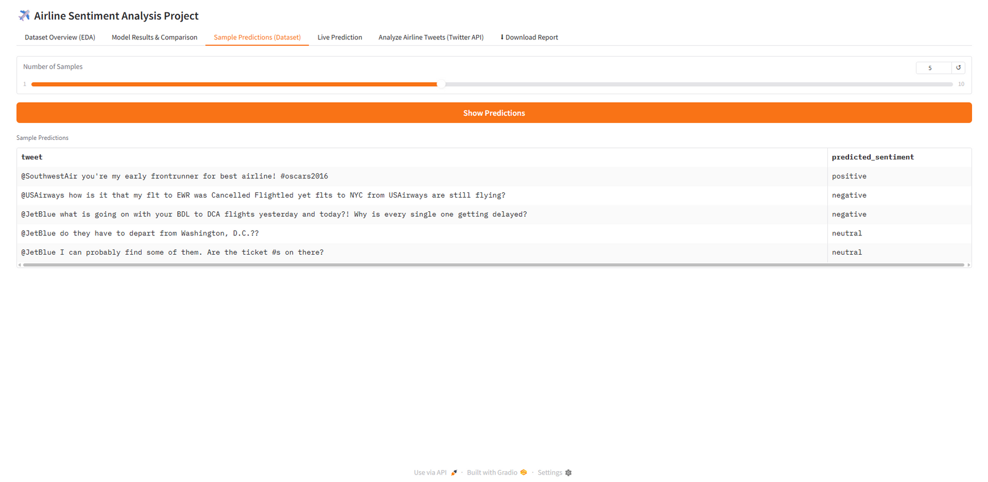
Figures 14 showing interface pages

Slide 22
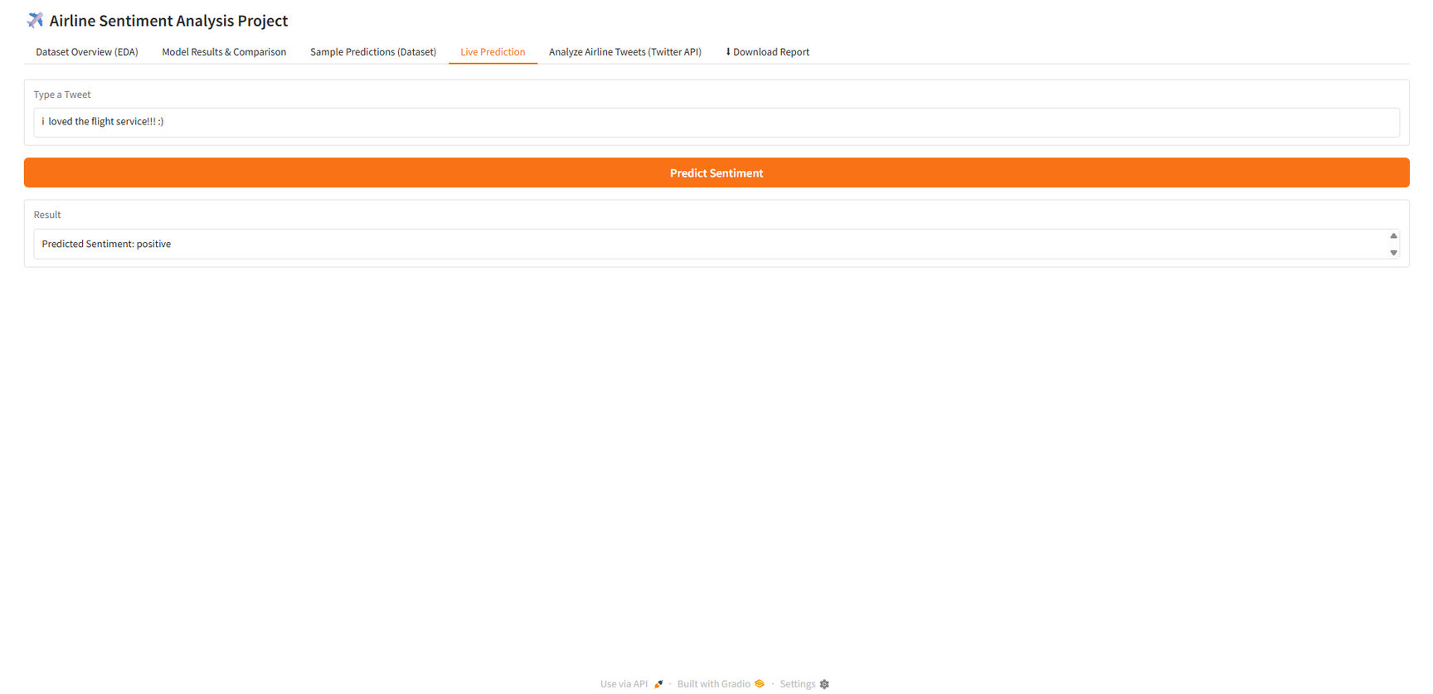
Figures 15 showing interface pages

Slide 23
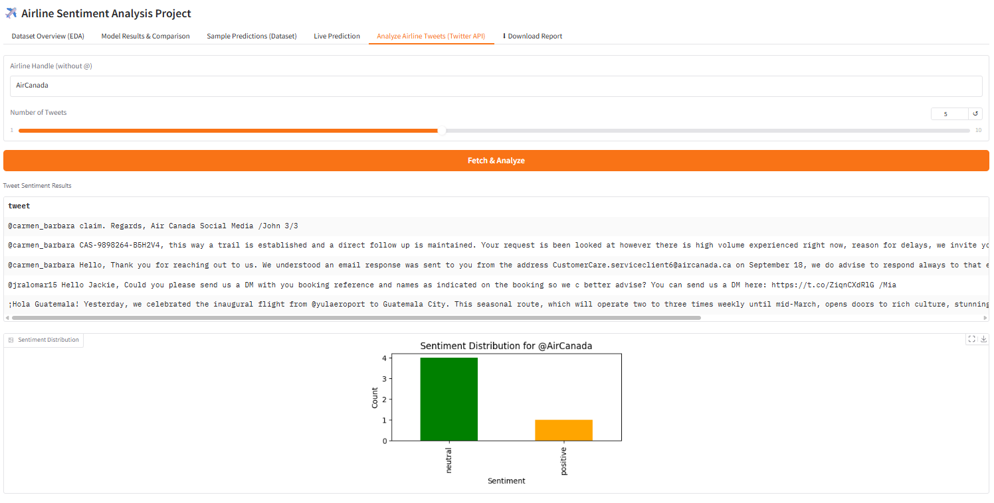
Figures 16 showing interface pages

Slide 24
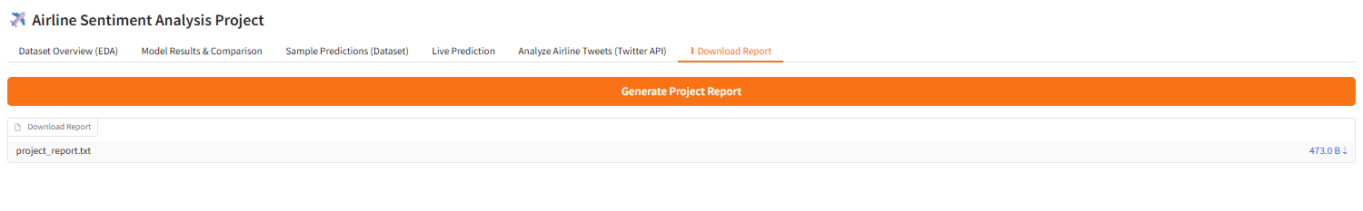
Figures 17 showing interface pages

Slide 25
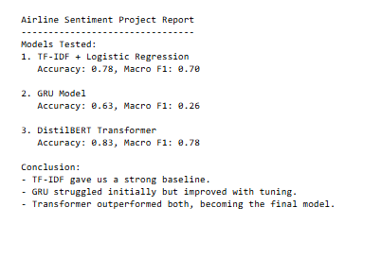
Figures 18 showing txt file

Slide 26
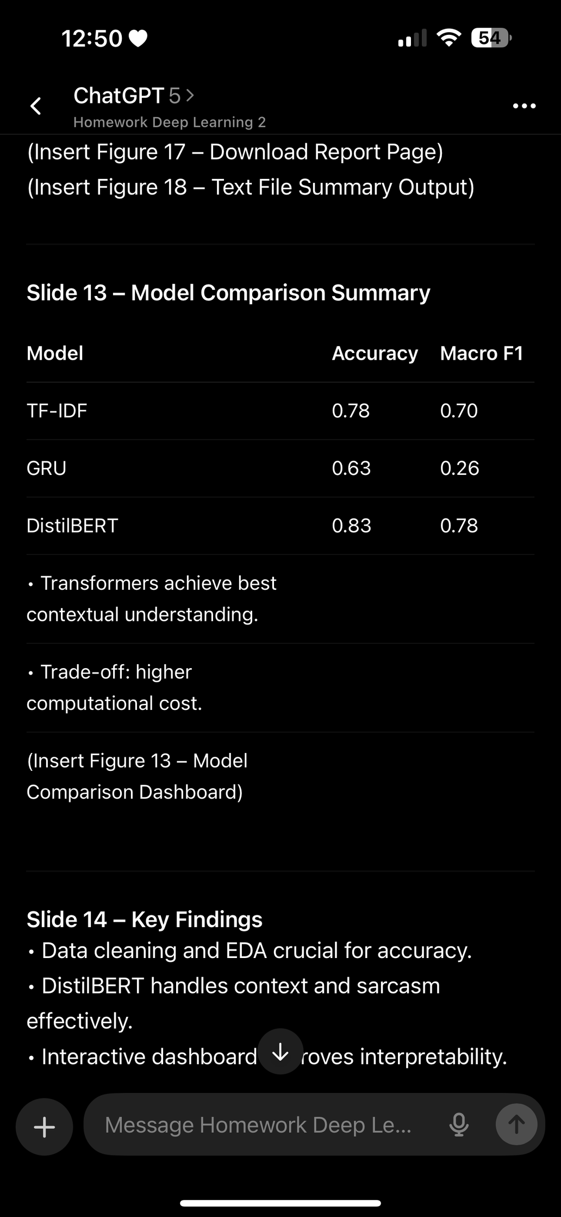
Model Comparison Summary
Transformers achieve best contextual understanding.
Trade-off: higher computational cost.

Slide 27
Key Findings
• Data cleaning and EDA crucial for accuracy.
• DistilBERT handles context and sarcasm effectively.
• Interactive dashboard improves interpretability.

Slide 28
Limitations &
Future Work
• Dataset limited to U.S. airlines.
• Class imbalance affected GRU performance.
• Future plans: multi-lingual data, real-time API integration, mobile deployment.

Slide 29
References
Kaggle. (n.d.). Twitter US Airline Sentiment Dataset.
Hugging Face (2024). CardiffNLP/twitter-roberta-base-sentiment-latest.
TensorFlow (2024). Text Classification with Keras.
Gradio (2024). Interactive ML Demos.
Tweepy (2024). Twitter API for Python.

Slide 30
Thank You / Q & A
Thank you for listening.
Questions and feedback are welcome.
Faimina Bharatbhai Khokhani | ID 101502974

